Slide 1
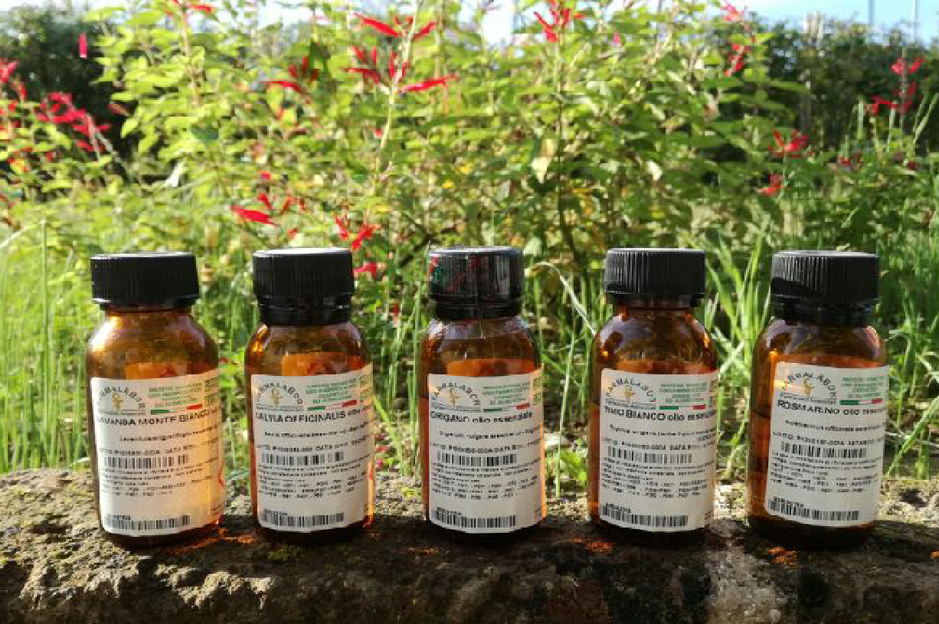
The essential oil

Slide 2
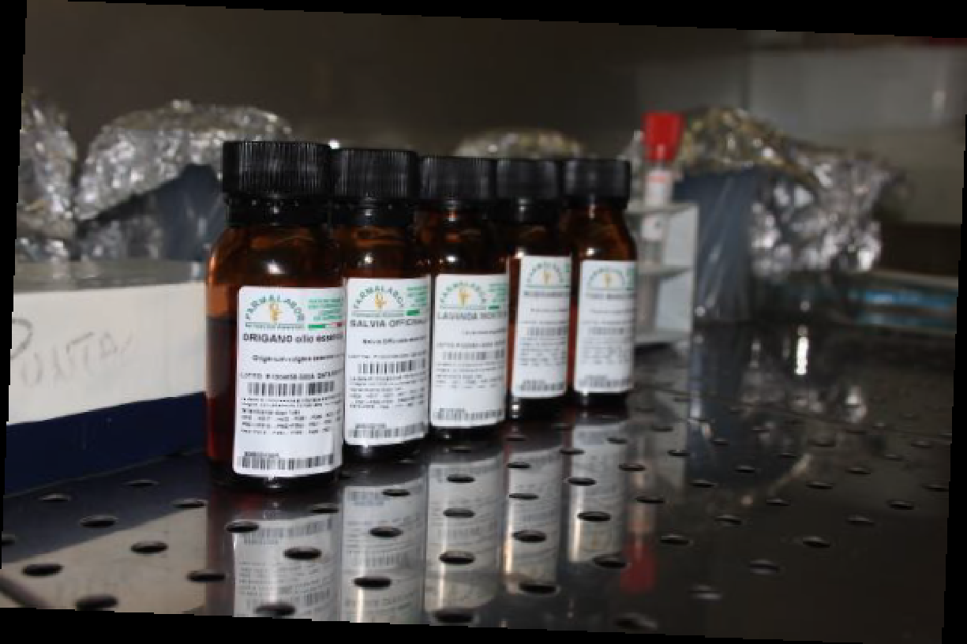
Essential oils
Essential oils are very complex mixture of secondary metabolites. Every type of essential oil has its own specific chemical composition based on the plant species and on the particular characteristics of the plant from which the oil was extract.

Slide 3
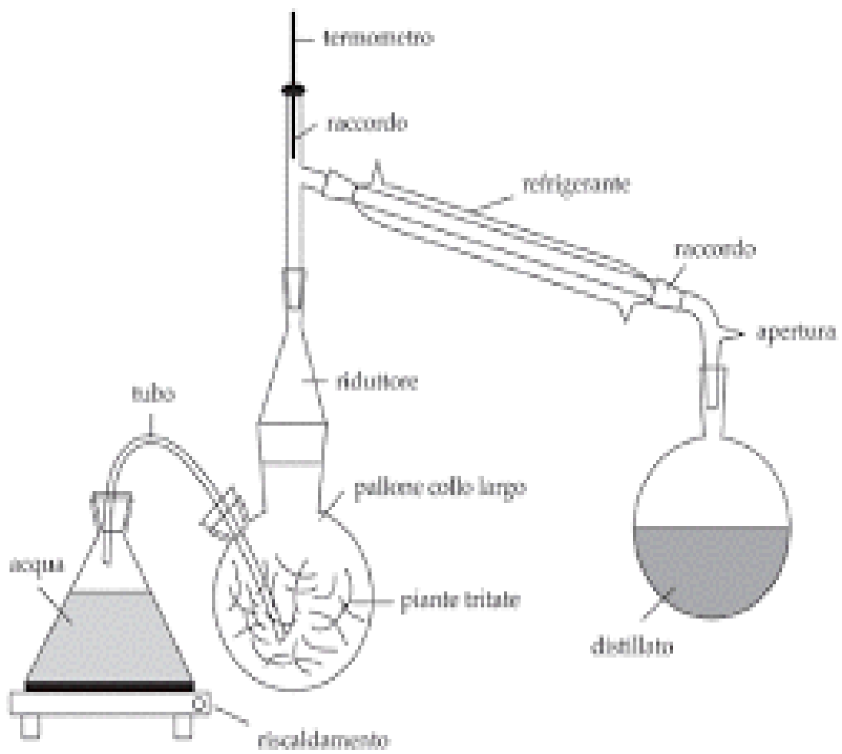
Essential oil Extraction
Steam distillation is a particular process used in case of thermolabile substances, such as natural aromatic compounds, that can be degraded at the boiling temperature. The addition of water or water vapor, inside the distillation column, lowers the boiling point of substances, allowing the separation by distillation. The product consists of a mixture of water and aromatic compounds which can be easily separated.

Slide 4
AROMATOGRAM
The aromatogram is a test used to determine the antibacterial activity of essential oils. Methodically, the aromatogram resembles an antibiogram: a plate diffusion test, the oil is introduced into the center of a bacteria-laden petri dish. A clear zone indicates the bactericidal activity of the oil. The greater the diameter of the zone, the higher the efficacy of the oil.

Slide 5
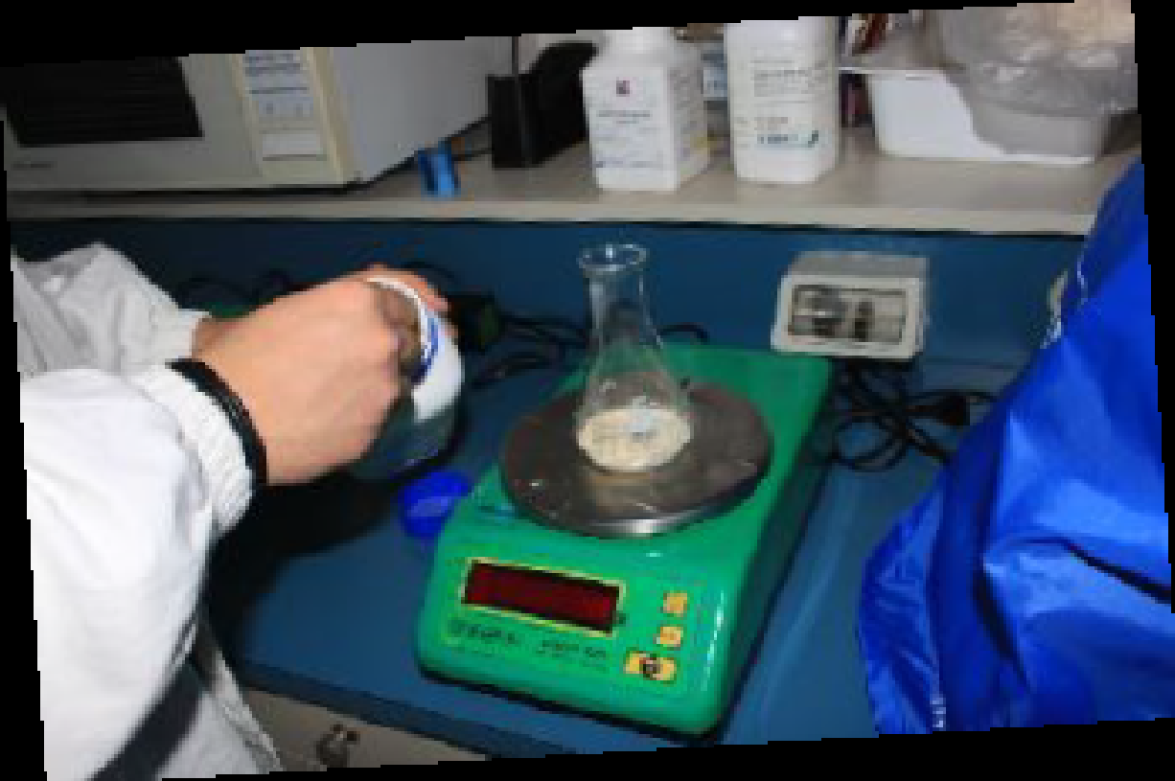
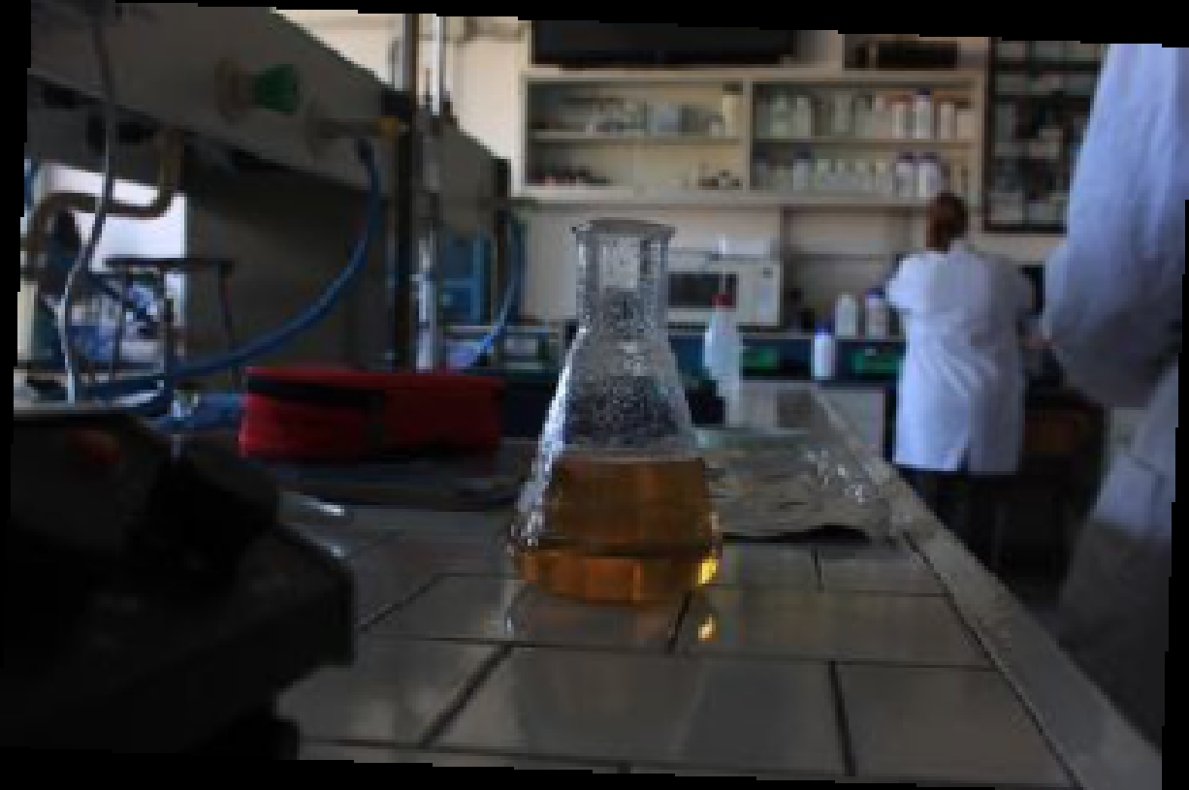
Method
• Prepare 400 ml of Mueller Hinton agar medium
• Sterilize at 121 ° C for 15 minutes

Slide 6
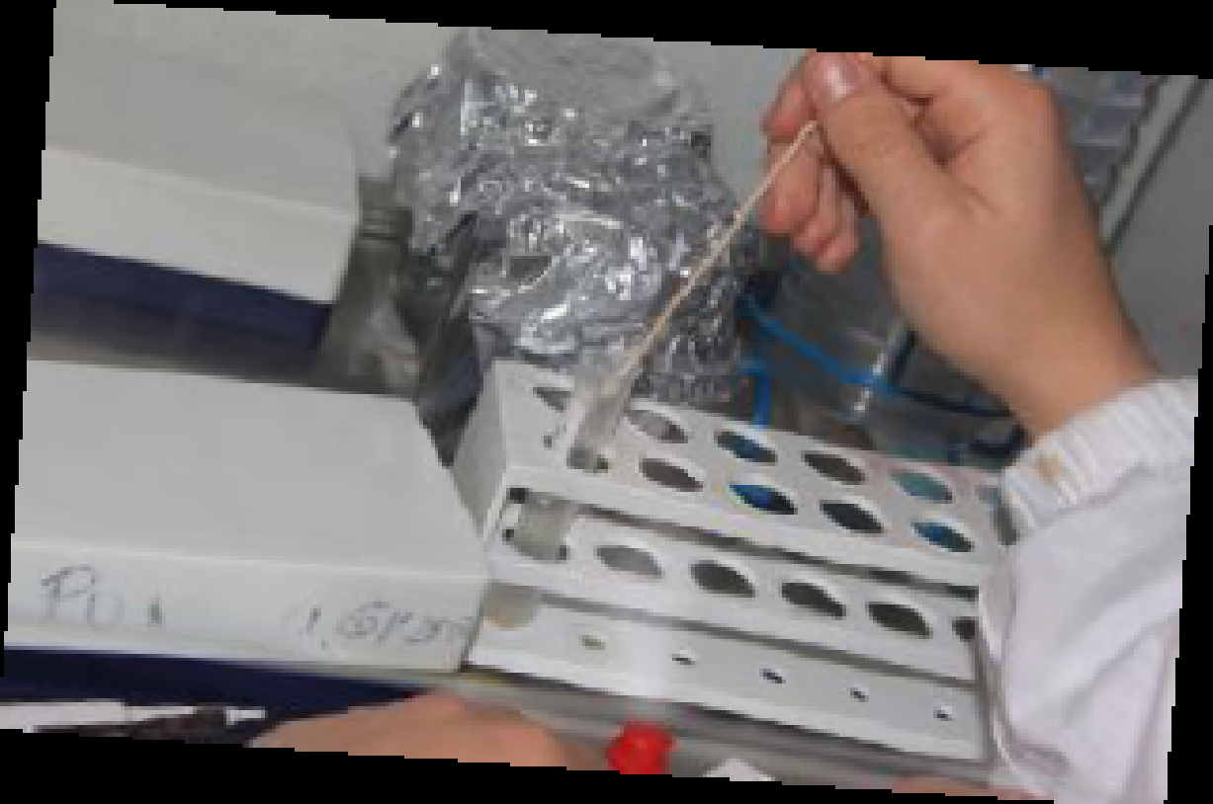
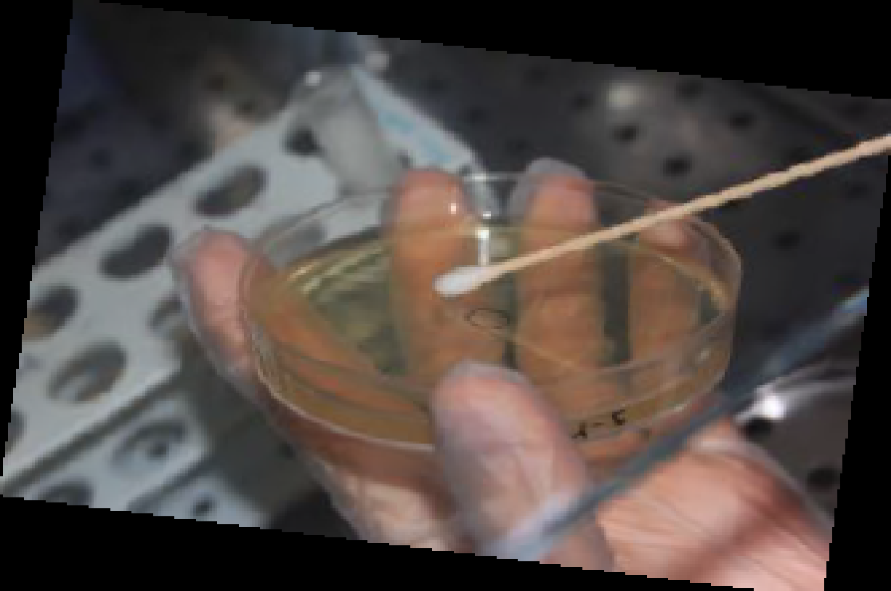
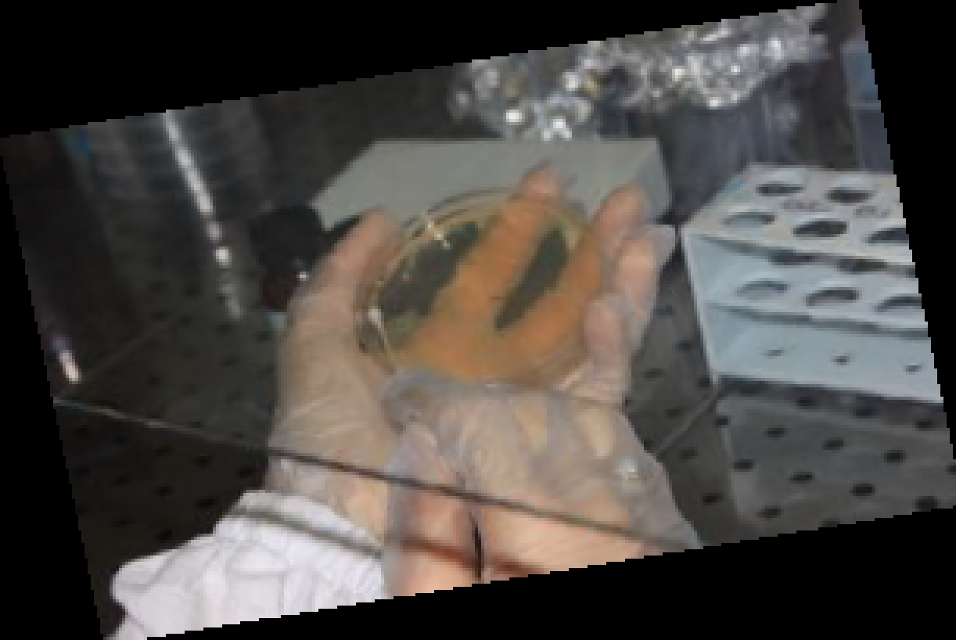
Method
• Pour the medium into the sterile petri dishes under the laminar flow hood (about 20 ml per plate, about 4 mm)
• Prepare the bacterial suspensions by dissolving one or more colonies in sterile physiological solution, compare the torpidity obtained with the suspension of Mac Farland 0.5 which corresponds to 106 bacteria / ml
• Mark the plates with the sown species and the essential oil used
• Inoculate the plates with the bacterial suspensions using a swab in order to obtain a homogeneous and confluent growth

Slide 7
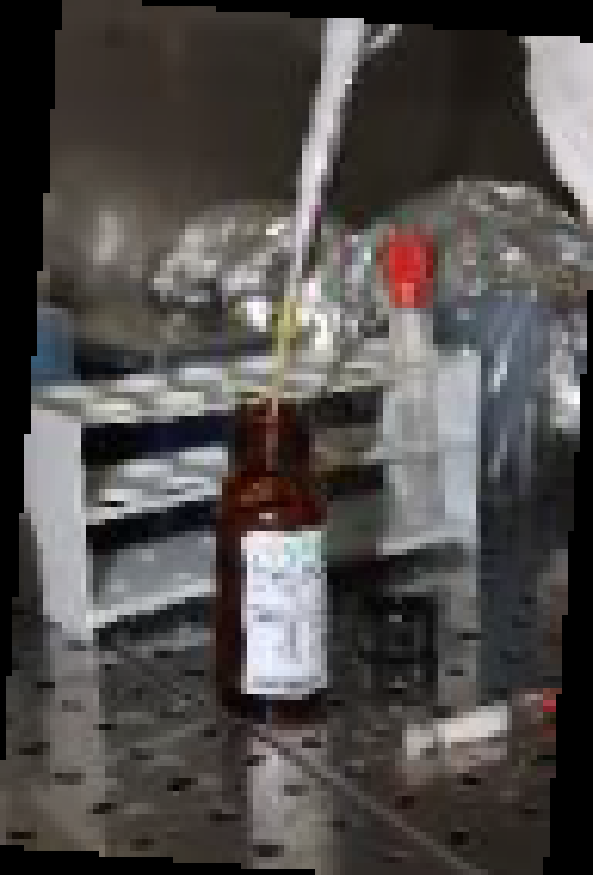
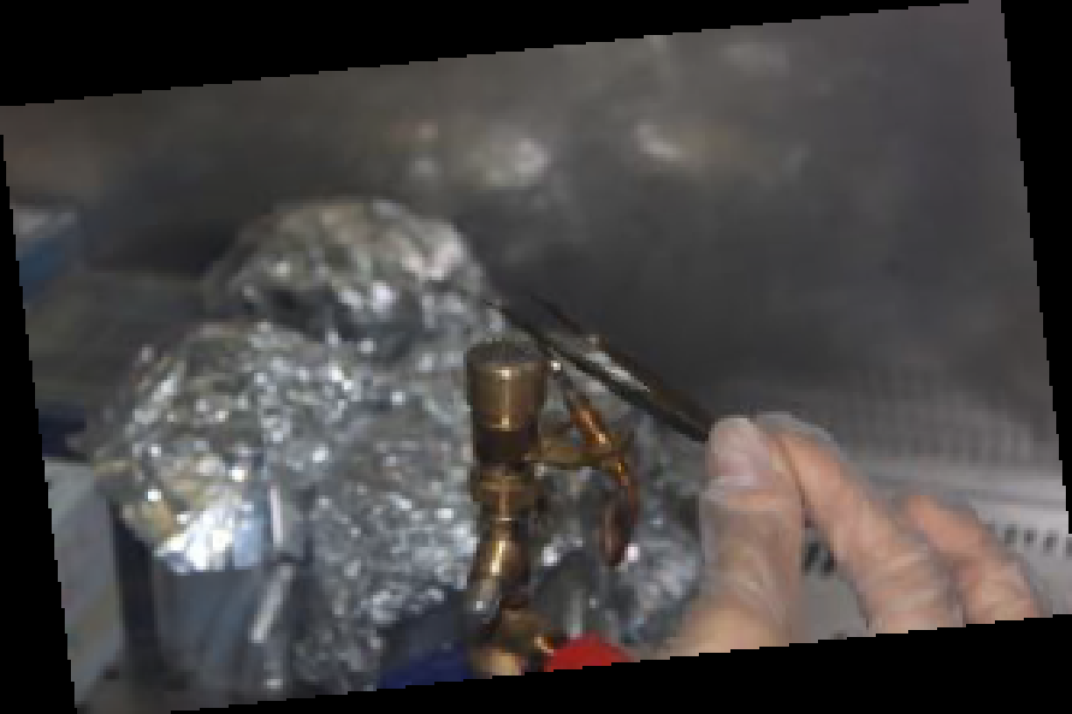
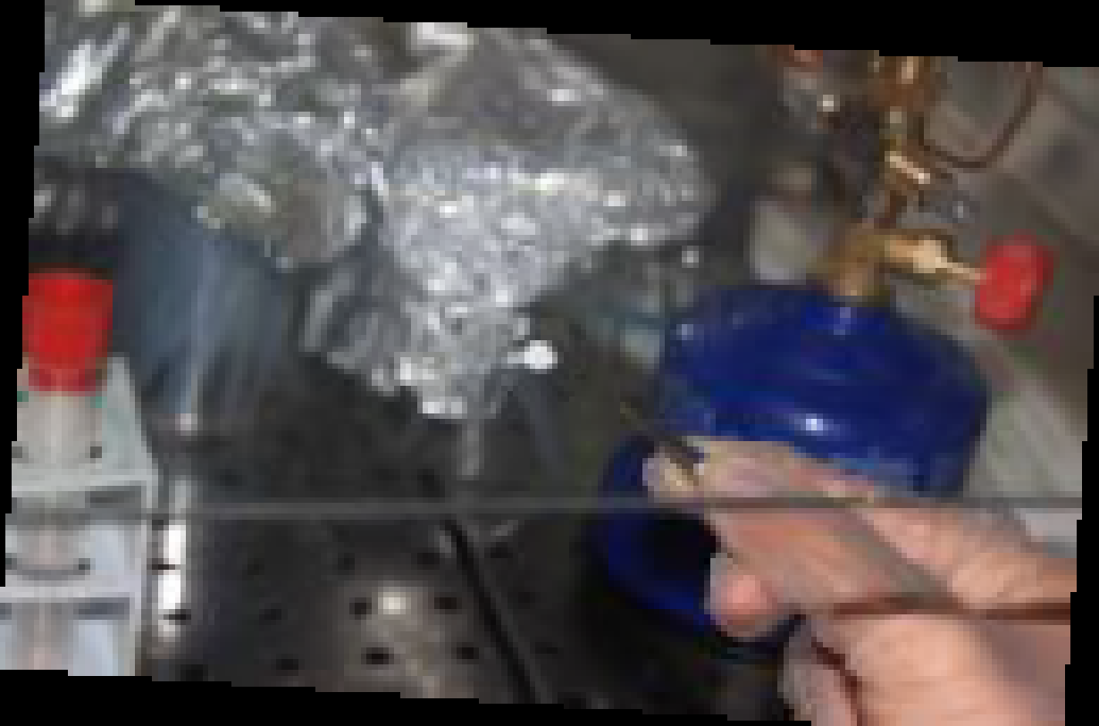
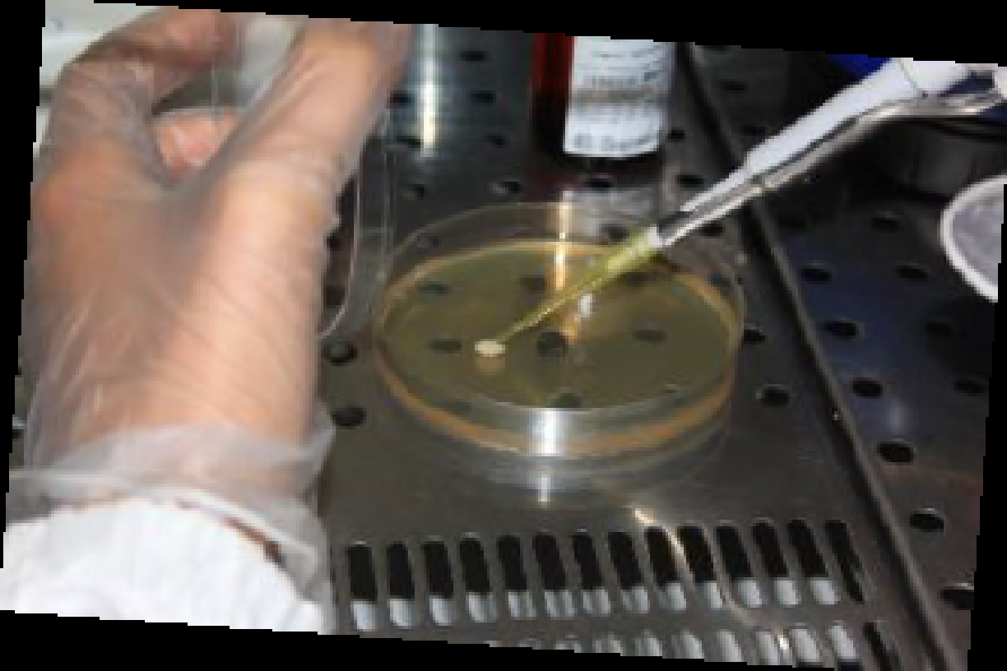
Method
• impregnate sterile paper disks with a specific concentration of each essential oil and place them onto agar plates
• Incubate the plates in the thermostat for 24 hours at 37 ° C

Slide 8
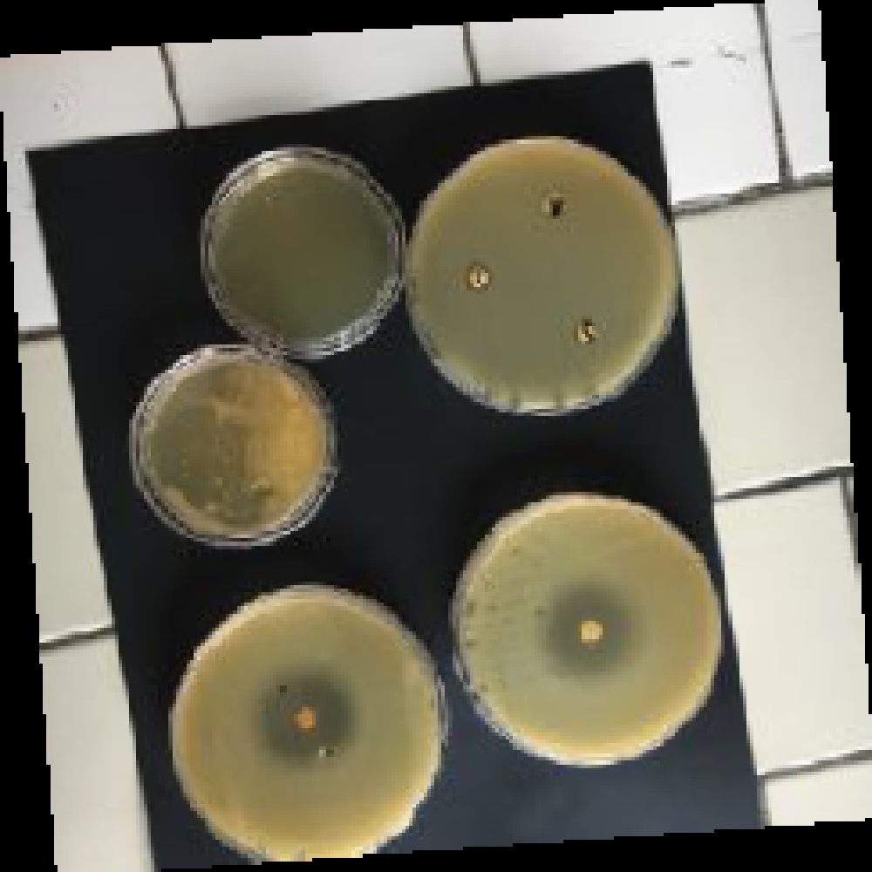
Method
•Measure the inhibitory zones obtained and report the results in a table.

Slide 9
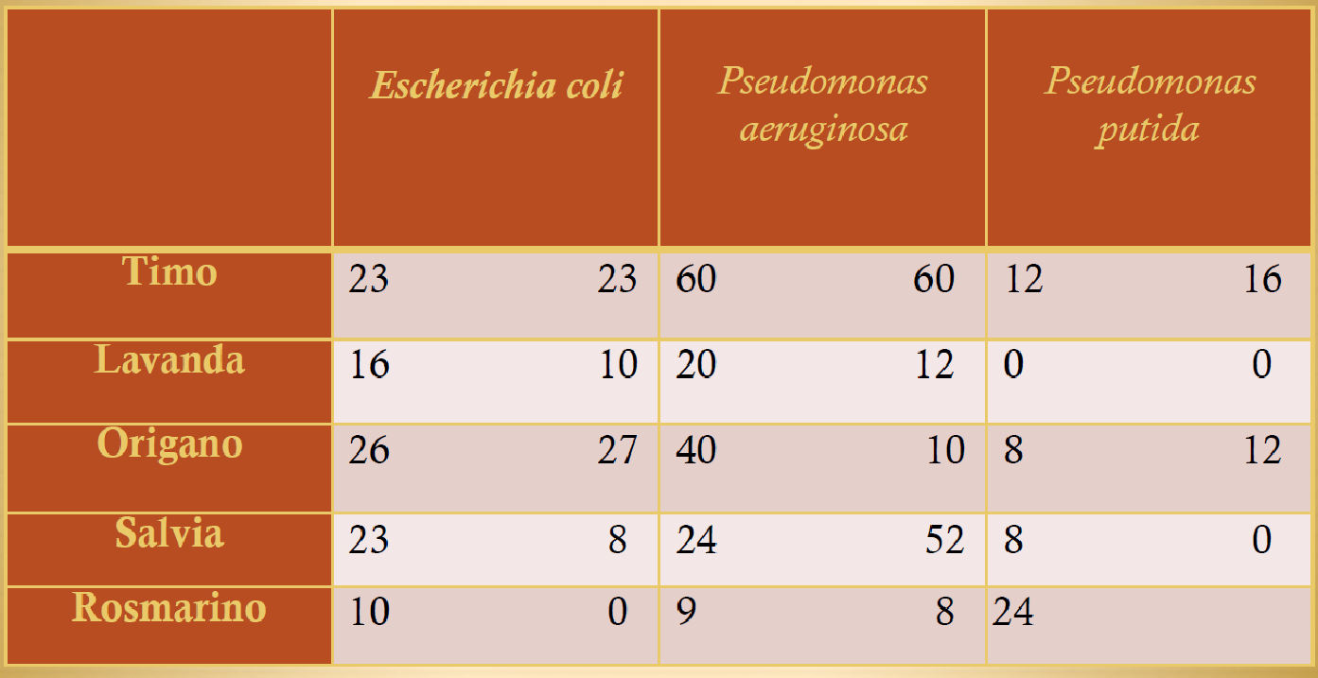
Table
•Report the results in a table.

Slide 10
CONCLUSION
This laboratory experience allowed us to observe the different antimicrobial activity of five different types of essential oils: thyme oil, lavender, oregano, sage, rosemary with three different species of bacteria: Escherichia coli, Pseudomonas aeruginosa, Pseudomonas putida. As we can see in the table the essential oil of thyme and oregano, that are part of the same family, have the highest bactericidal effect.

