Slide 1
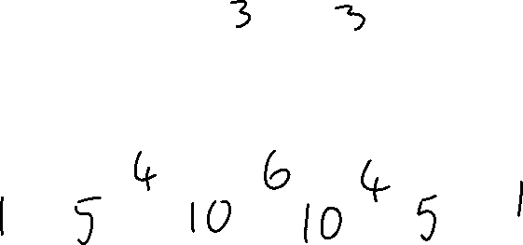
Pascal’s Triangle
23/03/22
Can you spot a pattern?
What would the next 3 rows look like?

Slide 2
Pascal’s Triangle
Outstanding progress today is…
…to use pascal’s triangle in the expansion of expressions with powers up to 5.

Slide 3
We Do
Expanding Double Brackets

Slide 4
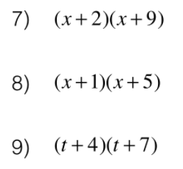
We Do
Expanding Double Brackets

Slide 5
We Do
Expanding Double Brackets

Slide 6
We Do
Expanding Triple Brackets
$$(x+1)(x+2)(x+5)=$$

Slide 7
We Do
Expanding Triple Brackets

Slide 8
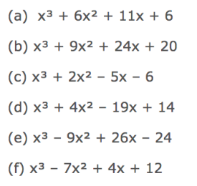
We Do
Expanding Triple Brackets

Slide 9
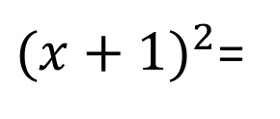
We Do
Expanding Double Brackets
${(x+1)}^{2}$=

Slide 10
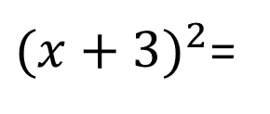
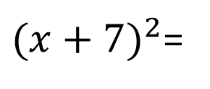
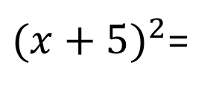
We Do
Expanding Double Brackets
${(x+3)}^{2}$=
${(x+5)}^{2}$=
${(x+7)}^{2}$=

Slide 11
We Do
Expanding Double Brackets
${(x+3)}^{2}$=
${(x+5)}^{2}$=
${(x+7)}^{2}$=

Slide 12
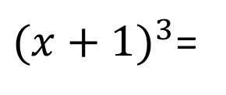
We Do
Expanding Triple Brackets
${(x+1)}^{3}$=

Slide 13
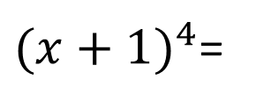
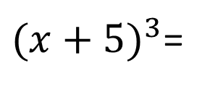
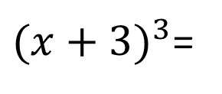
We Do
Expanding Brackets of Larger Powers
${(x+3)}^{3}$=
${(x+5)}^{3}$=
${(x+1)}^{4}$=

Slide 14
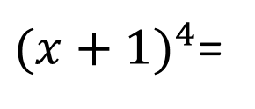
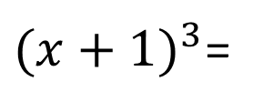
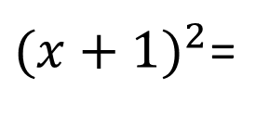
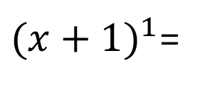
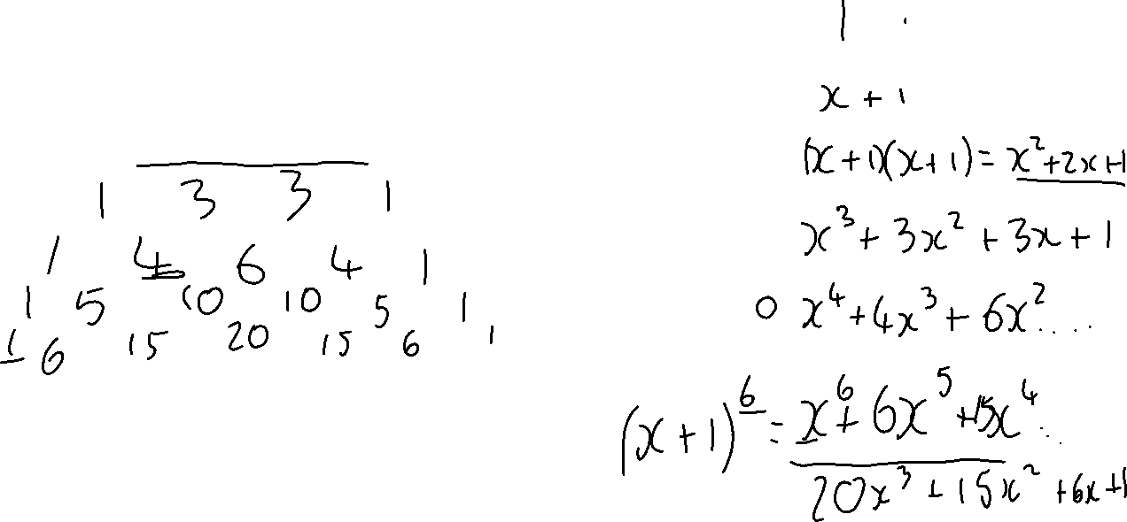
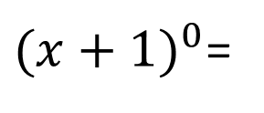
We Do
Using Pascal’s Triangle
${(x+1)}^{0}$=
${(x+1)}^{1}$=
${(x+1)}^{2}$=
${(x+1)}^{3}$=
${(x+1)}^{4}$=

Slide 15
We Do
Using Pascal’s Triangle
${(x+1)}^{0}$=
${(x+1)}^{1}$=
${(x+1)}^{2}$=
${(x+1)}^{3}$=
${(x+1)}^{4}$=
Pascal’s Triangle gives us the coefficients to the expansion of a set of brackets!

Slide 16
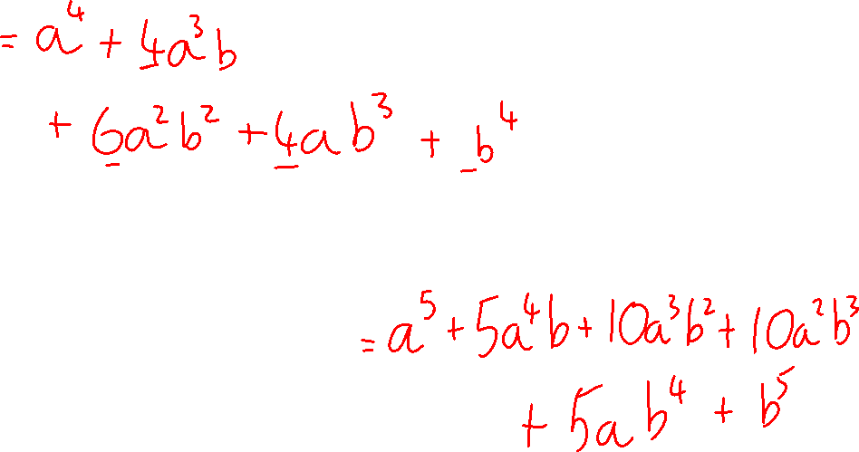
Using Pascal’s Triangle
We Do
I Do
Expand $(a+b)^{4}$
Expand $(a+b)^{5}$

Slide 17
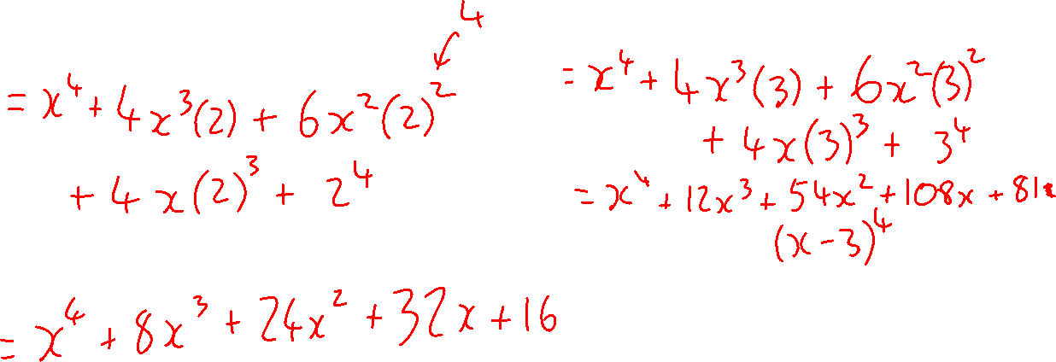
Using Pascal’s Triangle
We Do
I Do
Expand $(x+2)^{4}$
Expand $(x+3)^{4}$
Expand $(x+3)^{5}$

Slide 18
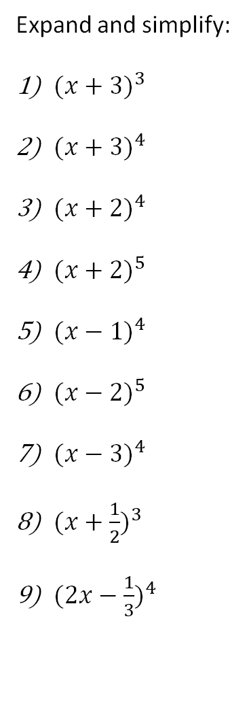
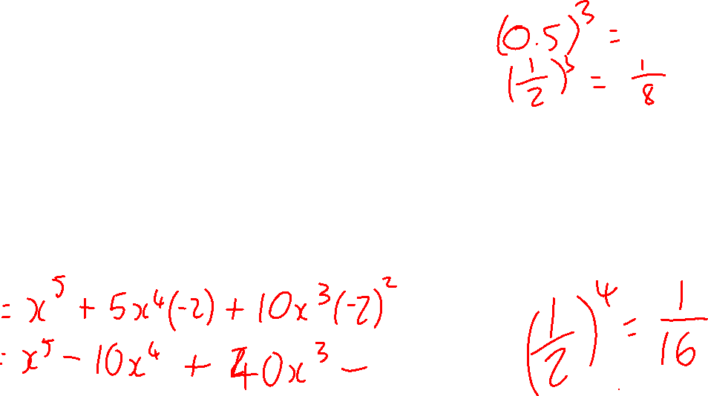
Using Pascal’s Triangle
We Do
You Do
Expand and simplify:
${(x+3)}^{3}$
${(x+3)}^{4}$
${(x+2)}^{4}$
${(x+2)}^{5}$
${(x−1)}^{4}$
${(x−2)}^{5}$
${(x−3)}^{4}$
${(x+\frac{1}{2})}^{3}$
${(2x−\frac{1}{3})}^{4}$

Slide 19
Using Pascal’s Triangle
We Do
You Do
Expand and simplify:
${(x+3)}^{3}$
${(x+3)}^{4}$
${(x+2)}^{4}$
${(x+2)}^{5}$
${(x−1)}^{4}$
${(x−2)}^{5}$
${(x−3)}^{4}$
${(x+\frac{1}{2})}^{3}$
${(2x−\frac{1}{3})}^{4}$

Slide 20
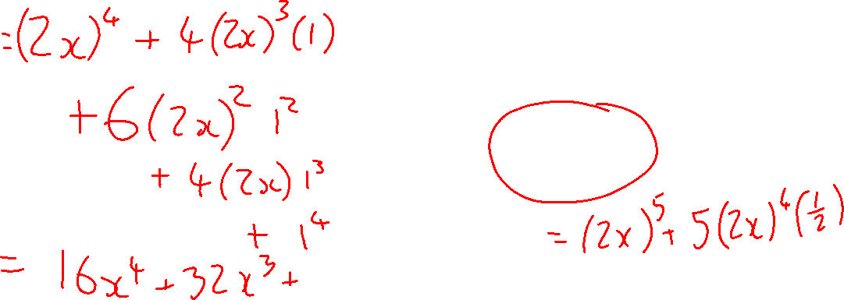
Using Pascal’s Triangle
We Do
I Do
Expand $(2x+1)^{4}$
Expand $(3x+2)^{4}$
Expand $(2x+\frac{1}{2})^{5}$

Slide 21
Using Pascal’s Triangle
We Do
You Do
Expand and simplify:
${(x+3)}^{3}$
${(x+3)}^{4}$
${(x+2)}^{4}$
${(x+2)}^{5}$
${(x−1)}^{4}$
${(x−2)}^{5}$
${(x−3)}^{4}$
${(x+\frac{1}{2})}^{3}$
${(2x−\frac{1}{3})}^{4}$
Challenge:
${(2x+3)}^{3}$
${(2x+3)}^{4}$
${(3x+2)}^{4}$
${(3x+2)}^{5}$
${(2x−1)}^{4}$
${(3x−2)}^{5}$
${(2x−3)}^{4}$
${(4x+\frac{1}{2})}^{3}$
${(5x−\frac{1}{2})}^{4}$

