Slide 1
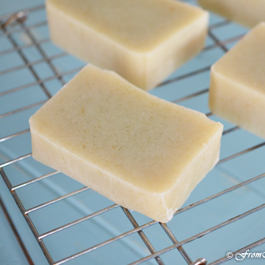
SOAP RECIPE

Slide 2
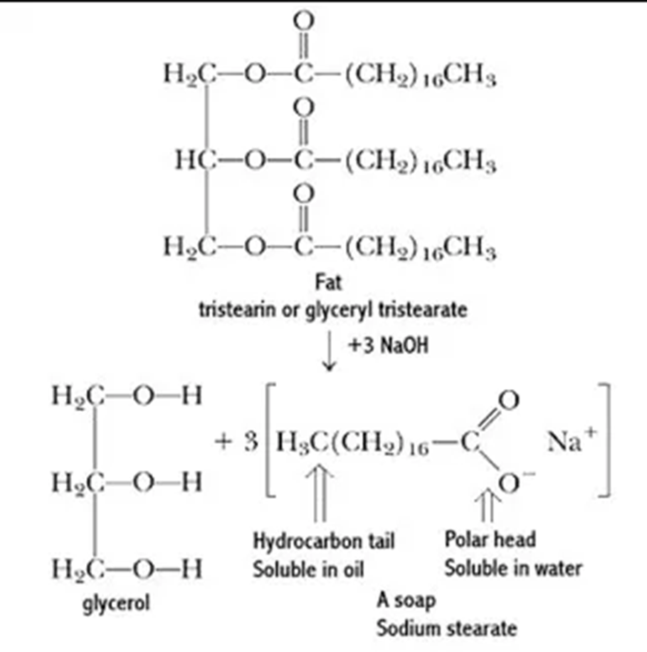
Saponification
Notes:
Saponification is a process that involves the conversion of fat, oil, or lipid, into soap and alcohol by the action of aqueous alkali (e.g. NaOH).^{[1][2]} Soaps are salts of fatty acids, which in turn are carboxylic acids with long carbon chains. A typical soap is sodium oleate.
Saponification can be defined as a “hydration reaction where free hydroxide breaks the ester bonds between the fatty acids and glycerol of a triglyceride, resulting in free fatty acids and glycerol,” which are each soluble in aqueous solutions. This process specifically involves the chemical degradation of lipids, which are not freely soluble in aqueous solutions. Heat-treated lipid residues are more difficult to remove than nonheat-treated residues due to polymerization. Saponification plays a critical role in cleaning lipids which are present in process areas involving cell growth and cell processing, such as bacterial fermentation and cell disruption process.
Cleaning Validation and Its Regulatory Aspects in the Pharmaceutical Industry S. Lakshmana Prabu, ... R. Thirumurugan, in Developments in Surface Contamination and Cleaning, 2015

Slide 3
Cleansing Action of Soap
Micelle Formation
www.geeksforgeeks.org/cleansing-action-of-soaps-and-detergents
Notes:
Cleansing Action of Soap
The dirt is generally oily in nature and insoluble in water. The soap cleanses the dirt by the process of micelle formation. Before we study the cleansing action of soap in detail, we need to understand what micelle is.
What is micelle?
A micelle is formed by the cluster of molecules where the molecules arrange themselves in a spherical shape with the hydrophobic end facing inwards and the hydrophilic end facing outwards.
The soap molecules form micelles in water and perform cleansing action as follows:
As we know soap has a hydrophobic and hydrophilic part, so when the soaps are dissolved in water, the hydrophilic end is attracted by water and faces outwards while the hydrophobic tail is repelled by water and faces inwards. The image shows soap molecules with the hydrophobic end facing away from water while the hydrophilic end facing towards water.
The soap molecule in form of micelles can clean the dirt as the dirt is now trapped within the micelle.
The micelles formed to make a colloidal solution with the water.
When the cloth or surface is washed with soap and water, the hydrophilic end gets attracted by water and the dirt molecule that has been trapped inside the micelle gets washed away with the water.

Slide 4
Coconut Almond Soap Recipe
This recipe includes:
Coconut Oil which provides hardness, and plenty of cleansing power,
Sweet Almond Oil for its moisturizing benefit,
and Olive Oil.
These three Oils produce a bar with a medium hardness, and a mild moisturizing lather.
If you like you can add a Fragrance Oil or skin-safe Essential Oil.

Slide 5
Ingredients
Ingrediants
57,5g water
12,5g Sweet Almond Oil (or jojoba)
37,5g Sodium Hydroxide (NaOH)
87,5g Coconut Oil
162,5g Olive Oil

Slide 6
Procedure
Prepare yourself by making sure you are suitably dressed in clothes and shoes that cover your arms, legs, and feet completely.
Gather your equipment, ingredients, and safety gear in a clean, secluded workspace where noone will be coming in and out.

Slide 7
Procedure
Weigh 37,5g of NaOH in a beaker.
Next add 57,5g of water and allow it to dissolve (under the hood).
Set the mixture aside in the hood, then move on to the next step.
Weigh 162,5g of Olive Oil (in another beaker).
Weigh 87,5g of Coconut Oil (in another beaker).
Melt the Coconut Oil

Slide 8
Procedure
7. Add the Olive Oil and the Almond Oil (12,5g or Jojoba) into ther melted Coconut Oil
8. Measure the temperature of the NaOH mixture and the oils temperature. When both the NaOH mixture and the oils mixture fall below 40°C they can be slowly mixed.
9. Begin stirring with wooden spoon, next with an immersion blender.
10. The mixture will need to be stirred until its surface is similar in consistency to a puddin or custard.
11. Add some drops of the Fragrance Oil and Pour the soap into your soap mold.

