Slide 1
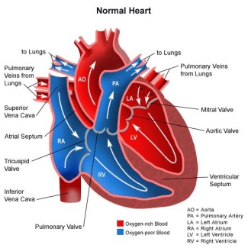
Heart structure and function
Thursday, 16 December 2021
Key words: Atria, ventricles, semi-lunar valves, atrio-ventricular valves
Live in 5: Copy and complete the facts about the heart.
The heart is made of _________ tissue.
The heart pumps _________ around the body.
The pulse (heart rate) is measured in ________.
The heart is made up of ____ chambers.

Slide 2
The big picture: “How does the structure of the heart allow it to function efficiently?”
Learning outcomes
To describe the structure of the heart.
To analyse the flow of blood through the heart.
To evaluate the hearts components to explain why it can function efficiently.

Slide 3
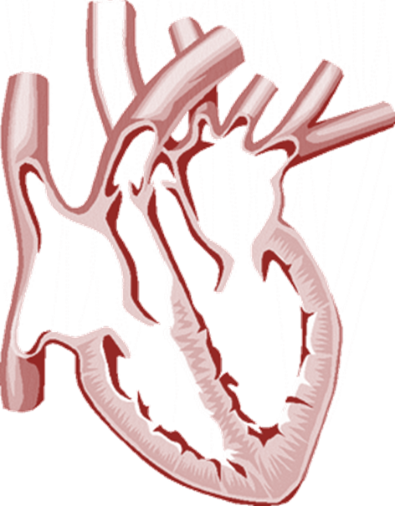
The Structure of the Heart
What do you know about the heart? How many parts can you label?
5 minutes
Extra challenge: Why does the left side of the heart have thicker walls than the right side?

Slide 4
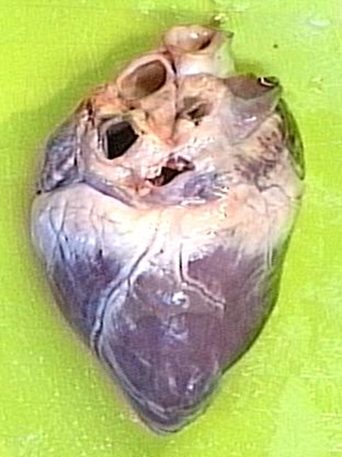
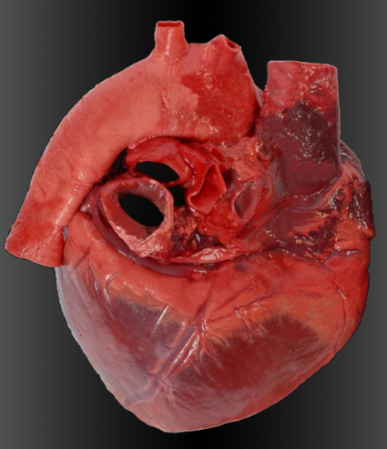
Heart dissection
In pairs or on your own dissect your heart using the instructions given.
Make sure you follow health and safety advice!

Slide 5
Blood flow through the heart…
Task
On your diagram, draw arrows to show the flow of blood through the heart and label the key parts.
Answer the key questions in the boxes.
Extension: construct a flow diagram to explain the blood flow in words.
You have 10 minutes

Slide 6
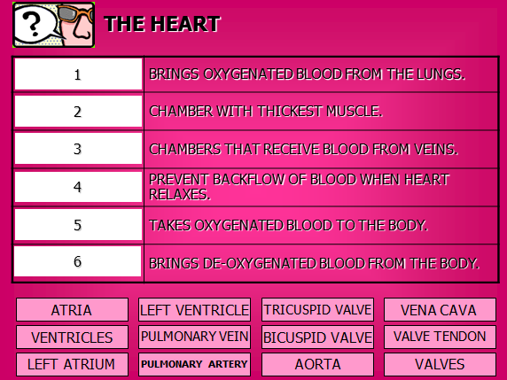

Slide 7
The big picture: “How does the structure of the heart allow it to function efficiently?” (4)

Slide 8
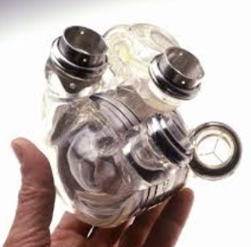
Artificial hearts
What considerations should be addressed when developing artificial hearts?

