Slide 1
Fibonacci

Slide 3
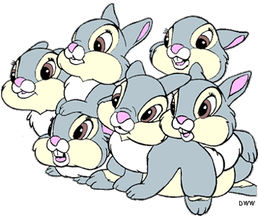
Challenge
Fibonacci’s Rabbits (A problem from 1202)
Suppose a newly born pair of rabbits, one male, one female, are put in a field. Rabbits are able to mate at the age of one month so that at the end of its second month a female can produce another pair of rabbits. Suppose that our rabbits never die and that the female always produces one new pair (one male, one female) every month from the second month on.
How many pairs will there be in one year?

Slide 4
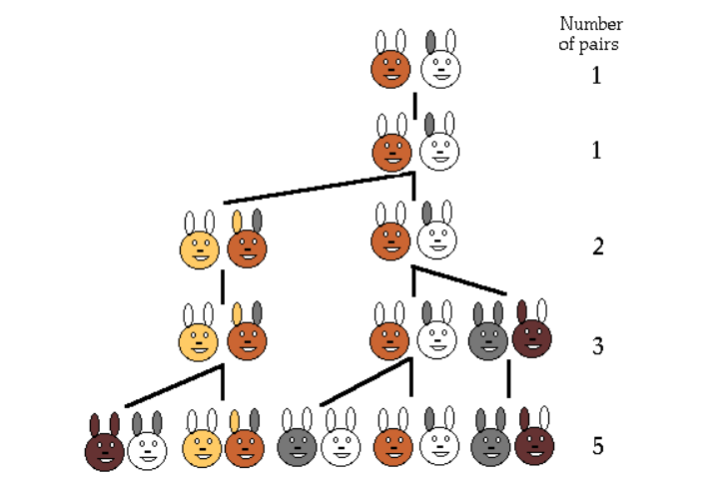
The number of pairs of rabbits in the field at the start of each month is:
1, 1, 2, 3, 5, ….
So how many pairs would there be in one year?
144

Slide 5
The sequence we have formed is called the Fibonacci sequence
1, 1, 2, 3, 5, 8, 13, 21, 34, ….
Leonardo of Pisa, who was known as Fibonacci, introduced this sequence to western civilization in 1202. It reveals a series of relationships that reflects much of the physical structure of nature.
Notes:
Ask how do we get the next term

Slide 6
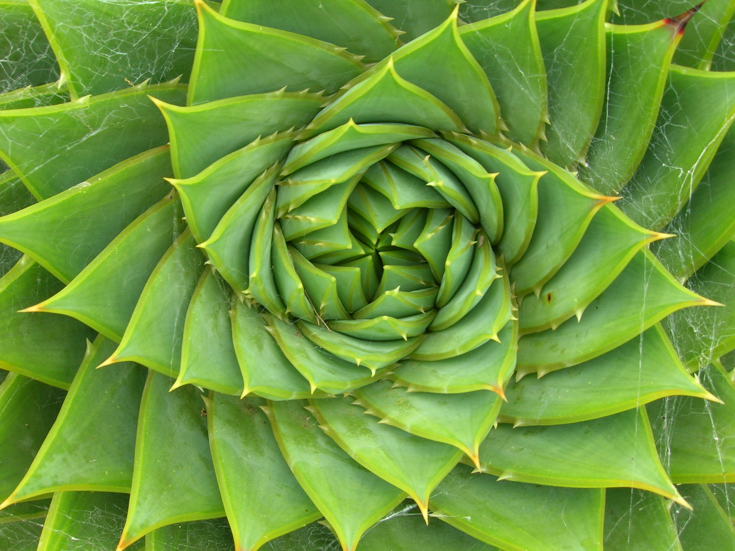
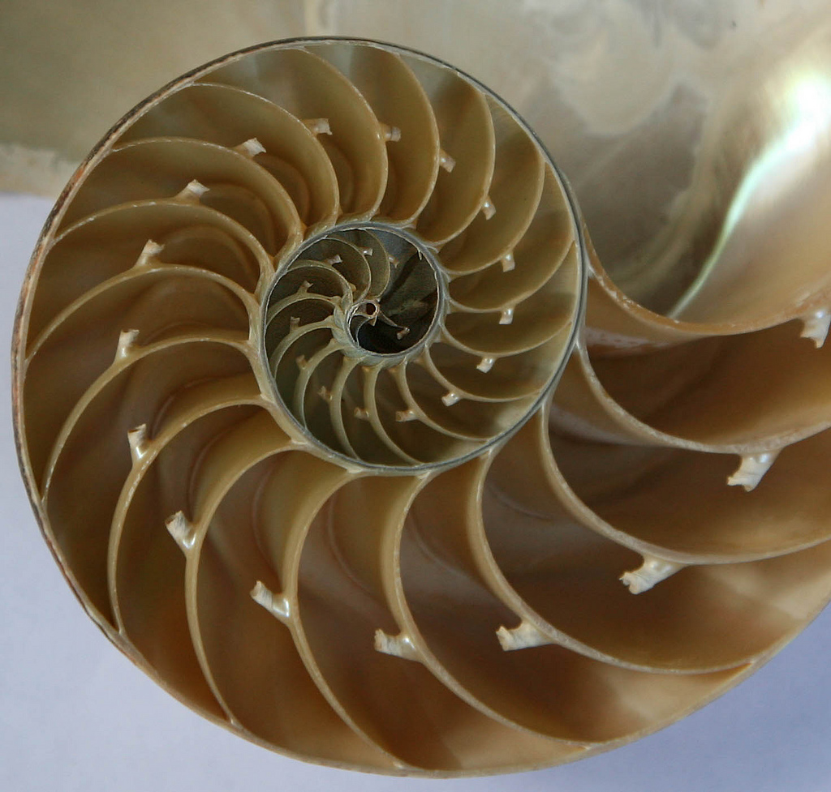
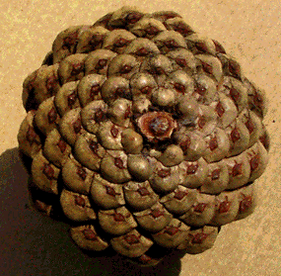
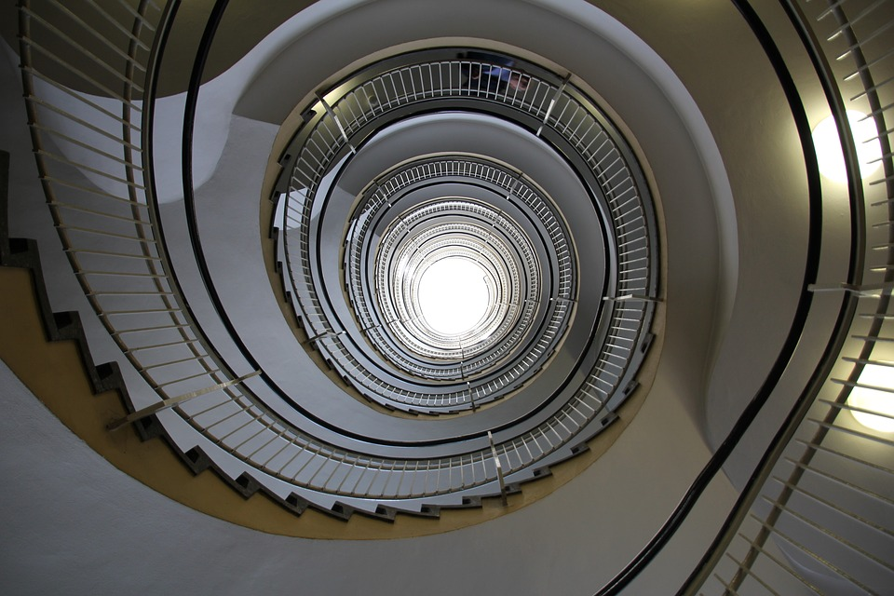
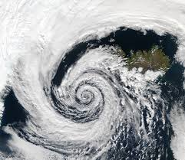
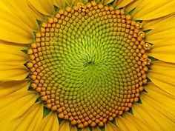
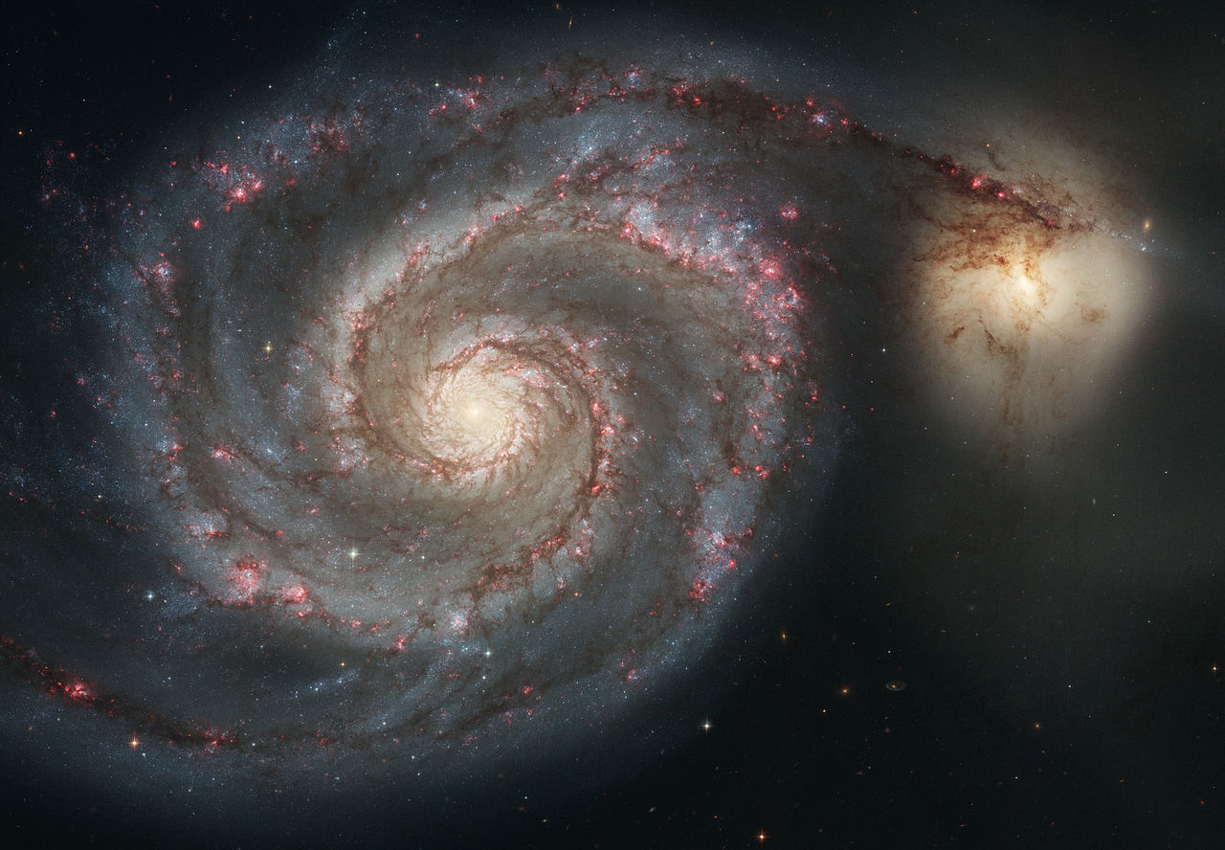

Slide 7
The sequence we have formed is called the Fibonacci sequence
1, 1, 2, 3, 5, 8, 13, 21, 34, ….
What are the next five terms?
55, 89, 144, 233, 377
Starting with 2 divide the term by the term before it. Keep doing this with bigger and bigger terms. What do you notice?
Notes:
Ask how do we get the next term

Slide 8
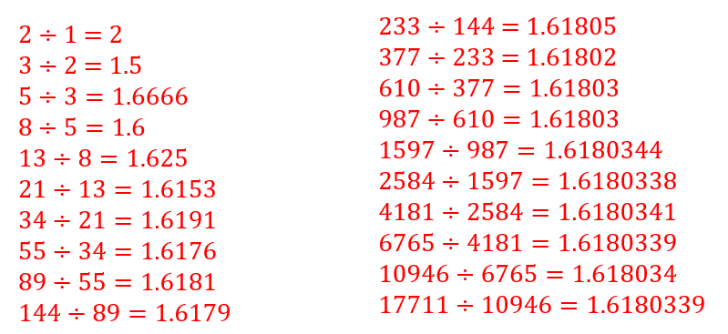
Dividing consecutive terms in the Fibonacci sequence:
What do you notice?

Slide 9
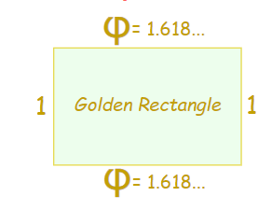
Phi $φ$ = 1.6180339…
This is known as the Golden Ratio.
Some artists and architects believe the Golden Ratio makes the most pleasing and beautiful shape.
This rectangle is in the Golden Ratio. You may notice credit cards and television screens are often the same!

Slide 10
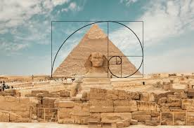
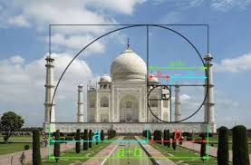
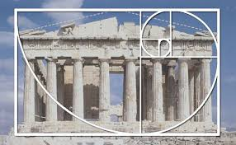
Golden Ratio in Architecture

Slide 11
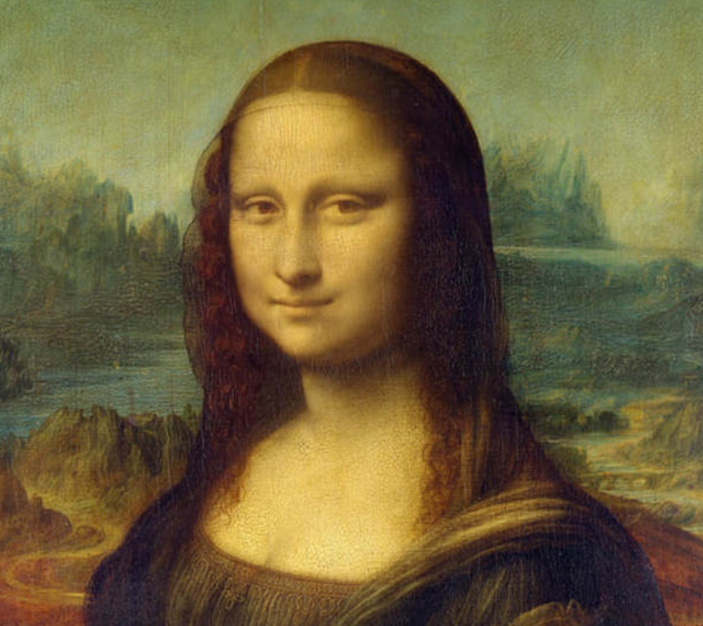
Maths in art
The Mona Lisa – it is thought that Da Vinci may have used the golden rectangle when paining this.

Slide 12
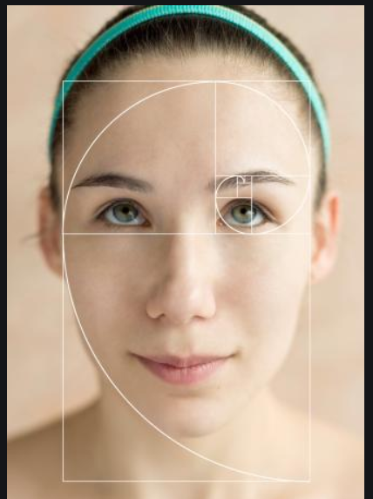
Challenge – Can you draw a golden face?
Your task is to be a budding Da Vinci’s and use the template provided to create your own face…

Slide 13
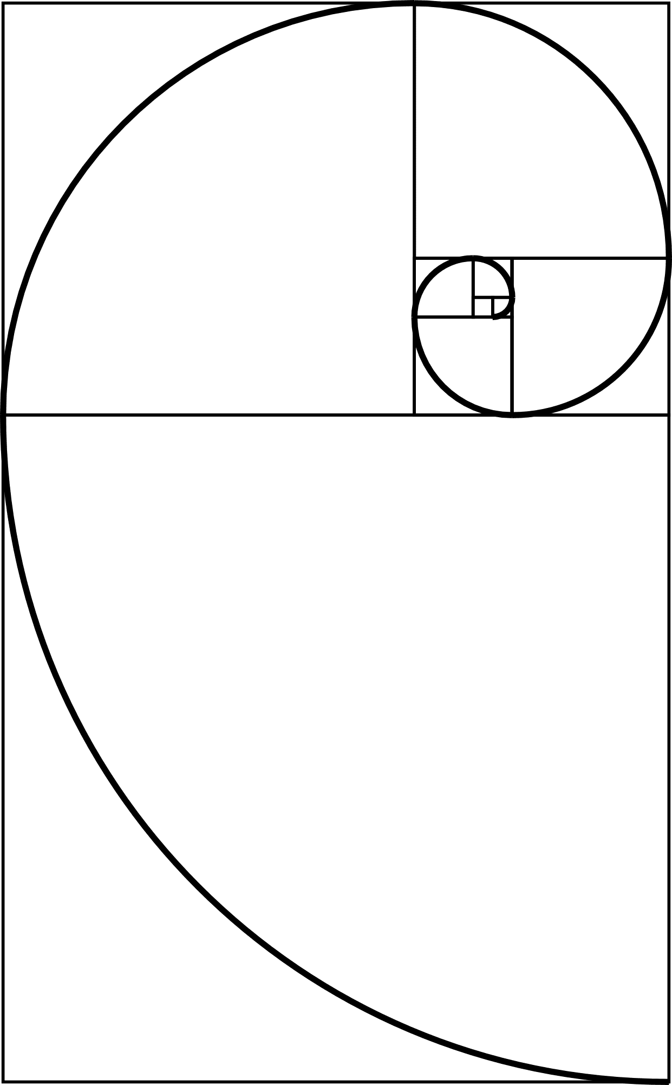
Notes:
Template need to print

Slide 14
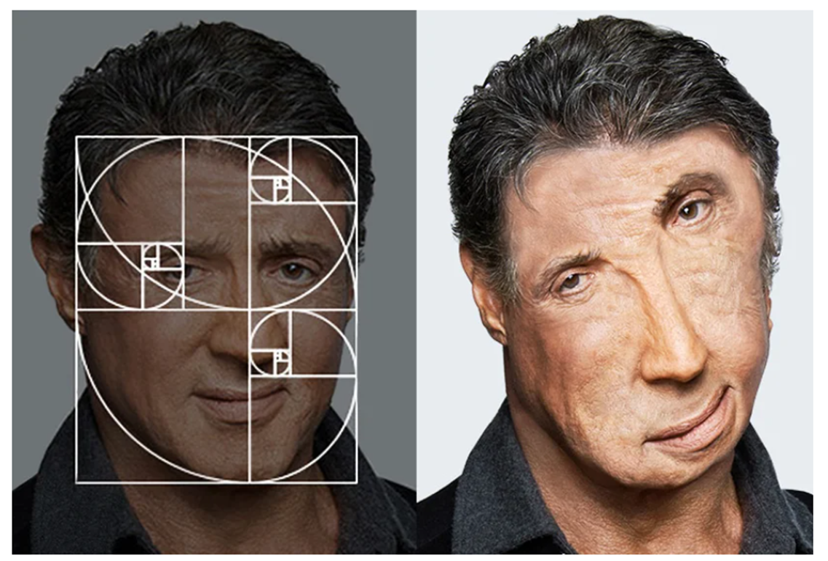
Of course it can still go wrong!!

