Slide 1
Welcome!
English lesson 3
Monday, 18 October 2021

Slide 2
Introductions…..
I want to know more about you.
You have 2 minutes to brainstorm some facts about yourself to feed back to everybody.

Slide 3
Let’s play a game!
2 truths, 1 lie
For example:
I am married with 2 children
I have visited Italy over ten times
I can crack the majority of bones in my body

Slide 4
Your turn….
You have 2 minutes to think of:
TWO FACTS about yourself
create 1 LIE about yourself
Do not tell anybody.
We will all share our truths and lie.
We will guess the correct and incorrect answers.

Slide 5
Idioms
Phrases that do not have an exact translation.
Using an idiom will make your English sound more natural.
They are used all the time.

Slide 6
Break a leg….
Good luck!

Slide 7
It is not rocket science…..
It is not difficult

Slide 8
Under the weather….
If somebody is feeling sick/ ill/ poorly then they are
‘under the weather’

Slide 9
Piece of cake….
It is easy

Slide 10
Get out of hand
When something is not under control

Slide 11
Idiom Quiz!
In the next slides you will see some English idioms.
There will be 3 answers for you to choose from.
You need to guess what it means.

Slide 12
No pain, no gain
You need to go to the gym.
You have to work for what you want.
Don’t hurt yourself.

Slide 13
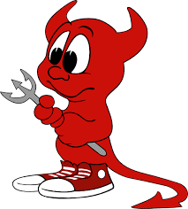
Speak of the devil
The person we were just talking about showed up!
Having a discussion about the devil.
Talking about the Manchester United mascot.

Slide 14
Better late than never
You are always late
It is better to be late than never arrive
What time is it?

Slide 15
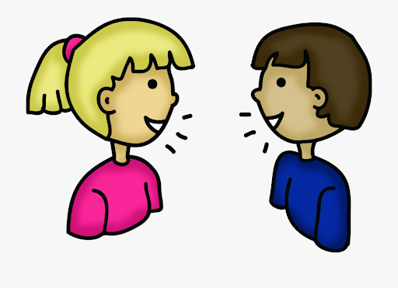
You can say that again
Repeat yourself
I agree with you
I didn’t hear you

Slide 16
Taste of your own medicine
Get treated the way you've been treating others (negative).
Taking your medicine.
You're better off not knowing

Slide 17
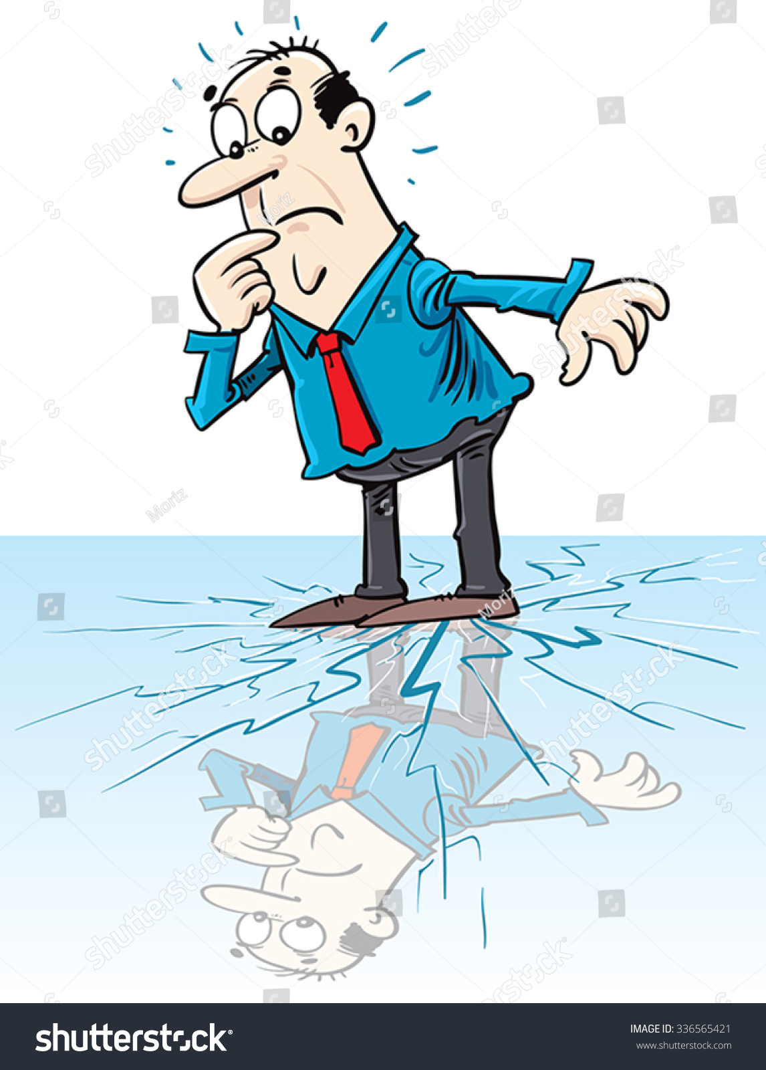
On thin ice
You are going to fall into the ice.
You are going to be in trouble.
You are going ice-skating.

Slide 18
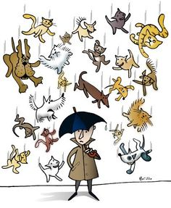
It’s raining cats and dogs
There are cats and dogs falling from the sky.
Cats and dogs have escaped.
It is raining a lot.

Slide 19
Can you match up the pairs?
Fish and ……….
………. and pepper
Day and ……
High and ………
………and outs
Now and ……..
Bits and ……..
……….. and forget
………..and slow
Wear and ………..
…………and tired
…………..and dine
On and ……….
Pick and …………
War and ……..
Fast
Sick
Tear
Off
Night
Peace
Bobs
Chips
Salt
Wine
Ins
Then
Choose
Forgive
Low

Slide 20
Best of both worlds
You live two lives
Enjoying two things at once
Talking about the positives of the world

Slide 21
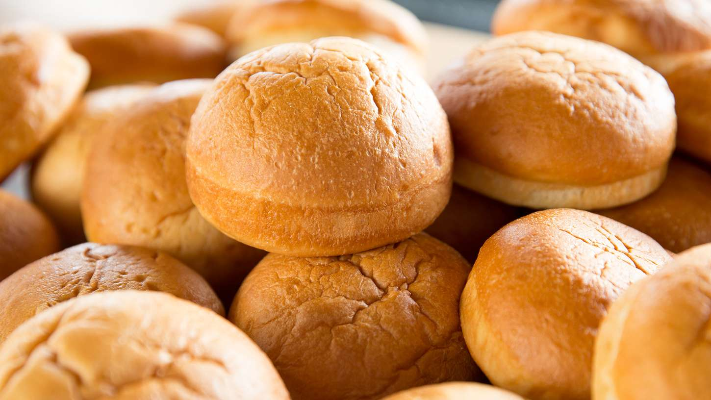
Items that even the English can’t decide what to call it….
Bread roll
Barm cake
Tea cake
Batch
Bun
Cob
Bap
Lunch time
Dinner time
Brew
Coffee
Tea
Breakfast
Lunch
Dinner
Breakfast
Dinner
Tea

Slide 22
Can you match up the pairs?
Fish and chips
Salt and pepper
Day and night
High and low
Ins and outs
Now and then
Bits and bobs
Forgive and forget
Fast and slow
Wear and tear
Sick and tired
Wine and dine
On and off
Pick and choose
War and peace

Slide 23
What ITALIAN words do the English use as if they are their own?
you have 2 minutes to think of as many as you can.

Slide 24
spaghetti
Pizza
influenza
Paparazzi
Volcano
lava
Solo
finale
scenario
panini
opera
Pasta
pepperoni

Slide 25
Stereotypes
Brainstorm some English AND Italian stereotypes.
We will then discuss and explain.

Slide 26
British Mannerisms
British people LOVE to talk about the weather!
We always say please and thank you for EVERYTHING.
We apologise for EVERYTHING.
Queuing is considered to be polite.
You greet people with a handshake.
You don’t begin your meal until everybody's has arrived.
British people are very sarcastic.
We don’t like to be late, it is rude to be late.
TEA – we drink LOTS of it.

Slide 27
CHARADES
On your webcam you will act out a word.
You can not speak.
The other people will try to guess your word.

