Slide 1

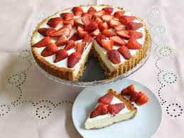
WELCOME!
ITALY/ACCRINGTON 2020
CHEESECAKE LESSON
YR11

Slide 2


Cheesecake history
The first “cheese cake” may have been created on the Greek island of Samos.
In Greece, cheesecake was a good source of energy, and there is evidence that it was served to athletes during the first Olympic games in 776 B.C.
The Classic New York style cheesecake is served with just the cake – no fruit, chocolate or caramel is served on the top or on the side. This famously smooth-tasting cake gets its signature flavour from extra egg yolks in the cream cheese cake mix.
Greek brides and grooms were also known to use cheesecake as a wedding cake
Cream cheese was an American addition to the cake, and it has since become a staple ingredient in the United States.
In 1872, a New York dairy farmer was attempting to replicate a French cheese. Instead, he accidentally discovered a process which resulted in the creation of cream cheese. Three years later, cream cheese was packaged in foil and distributed to local stores under the Philadelphia Cream Cheese brand.

Slide 3
NO BAKE-Cheesecake
FLAN DISH or VICTORIA SANDWICH TIN/SPRING FORM TIN
Method
In a mixing bowl add the 150g of biscuits and use a rolling pin or alternative to crush these biscuits.
Melt the margarine in a saucepan. Don't let it bubble. Melt until a yellow liquid
Remove from the heat.
Add melted butter to biscuit crumbs
Transfer the biscuit crumbs and butter to your tin and press the crumbs firmly into the base of the dish with the back of a spoon.
Wash the lemon. Grate the zest finely and squeeze out the juice into a clean mixing bowl.
Add the cream and whip the cream until thick.
Beat the cream cheese to soften it. Stir the cream cheese into the bowl with the cream, zest and juice
Fold in the sugar
Spread the mixture carefully over the biscuit base and chill before serving. (2-3 hours)
The top can be decorated with fruit if you wish.
150g crushed digestive biscuits
75g margarine
225g cream cheese (not the low fat cheese,
it doesn't work in this recipe)
125ml double cream (for whipping)
50g caster sugar
1 lemon, orange or lime- this can be any flavouring. (chocolate/strawberries/ vanilla essence
I will be decorating my cheesecake with strawberries so will be purchasing a small pack. You may decorate your cheesecake with whatever you like!

Slide 4
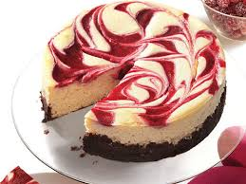
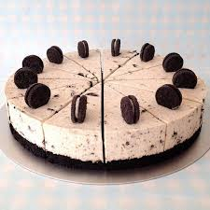
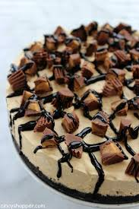
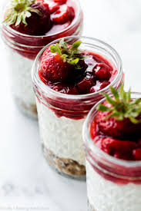
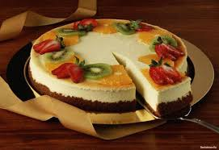
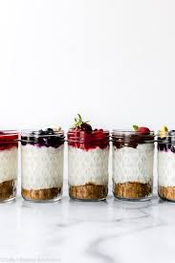
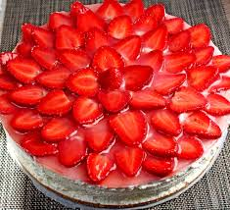
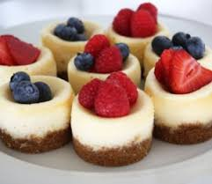
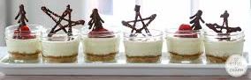

Slide 5
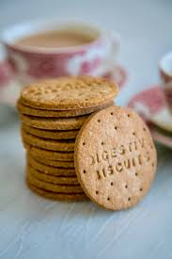
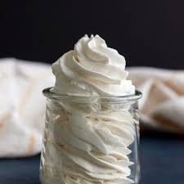
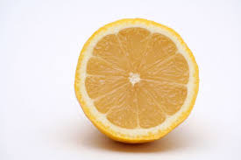
Dairy- Cream, cream cheese,
These items are to help bones and teeth become stronger and give elements of protein and fat too. These ingredients would not be suitable for Lactose intolerant people due to their inability to digest lactose the main carbohydrate in dairy products
Carbohydrates and sugar-
The biscuits will provide the main carbohydrate source to the dish but it is a simple carbohydrate so provides sugar (glucose) too!
This along with the butter gives the energy level (biscuit base) to the cheesecake.
Heavy whipping cream is the high-fat portion of raw dairy milk
Fresh, raw milk naturally separates into cream and milk.
The cream rises to the top due to its fat content. It’s then skimmed off before further processing
Fruit-
This can give natural sugars and creates the flavour to the dish.
It can give vitamins and minerals through different fruits e.g. lemon for vitamin C

