Slide 1
22/10/2021

Slide 2
Title: Lesson 1
Date: 22/10/2021
Outstanding Progress: To be able to describe your lego character
and give them a back story

Slide 3
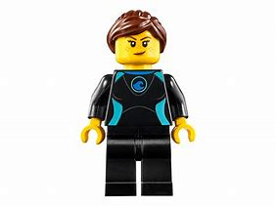
Task 1
Using the parts in front of you, build a lego figure and be able to describe it:
Give your character a name
Age
describe how it looks, colour of hair,
what it is wearing etc
Introduce your character to another character from the class

Slide 4
Task 2
Give your character a backstory and write this up in English
Where is your character from?
Does your character have a job?
Does your character have any special skills?
Anything else that would make your character particularly interesting?

