Slide 1
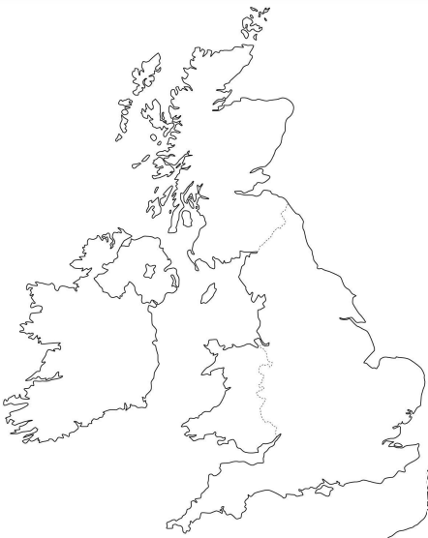
All about England
Tutto sull’Inghilterra
Live in 5 – label the map with the following places
Vivi in cinque – etichetta la tua mappa con i seguenti luoghi
_________
.
_________
.
Towns and Cities (Città) Countries (Paesi)
London (Londra) England (Inghilterra)
Accrington Northern Ireland (Irlanda del Nord)
Manchester Scotland (Scozia)
Edinburgh (Edimburgo) Wales (Galles)
Cardiff
Belfast
.
.
________
________
.
.

Slide 2
All about England
Tutto sull’Inghilterra
Live in 5 – label the map with the following places
Vivi in cinque – etichetta la tua mappa con i seguenti luoghi
Scotland
.
N. Ireland
Edinburgh
.
Belfast
Towns and Cities (Città) Countries (Paesi)
London (Londra) England (Inghilterra)
Accrington Northern Ireland (Irlanda del Nord)
Manchester Scotland (Scozia)
Edinburgh (Edimburgo) Wales (Galles)
Cardiff
Belfast
.
Accrington
.
Manchester
England
Wales
.
.
Cardiff
London

Slide 3
Accrington Facts and Figures (Accrington fatti e cifre)
Accrington is a town in the North West of England. The town has a population of 35,200. The local football club is called Accrington Stanley, which was founded in 1968. Accrington is 23 miles north of Manchester, the largest city in the area. Accrington is famous for Accrington NORI bricks, the hardest and densest bricks in the world!
Answer the questions in English
Rispondi alle domande in inglese
What is the population of Accrington?
What is Accrington Stanley?
How far is it to Manchester from Accrington?
True or false – Accrington is bigger than Manchester.
35,200
A football club
23 miles
false
Vocabolario
North West – nord-ovest
Population – popolazione
Football club – squadra di calcio
Founded in – fondata nel
Largest – più grande
Area – zona
Bricks - mattoni
Hardest and densest – più duri e densi

Slide 4
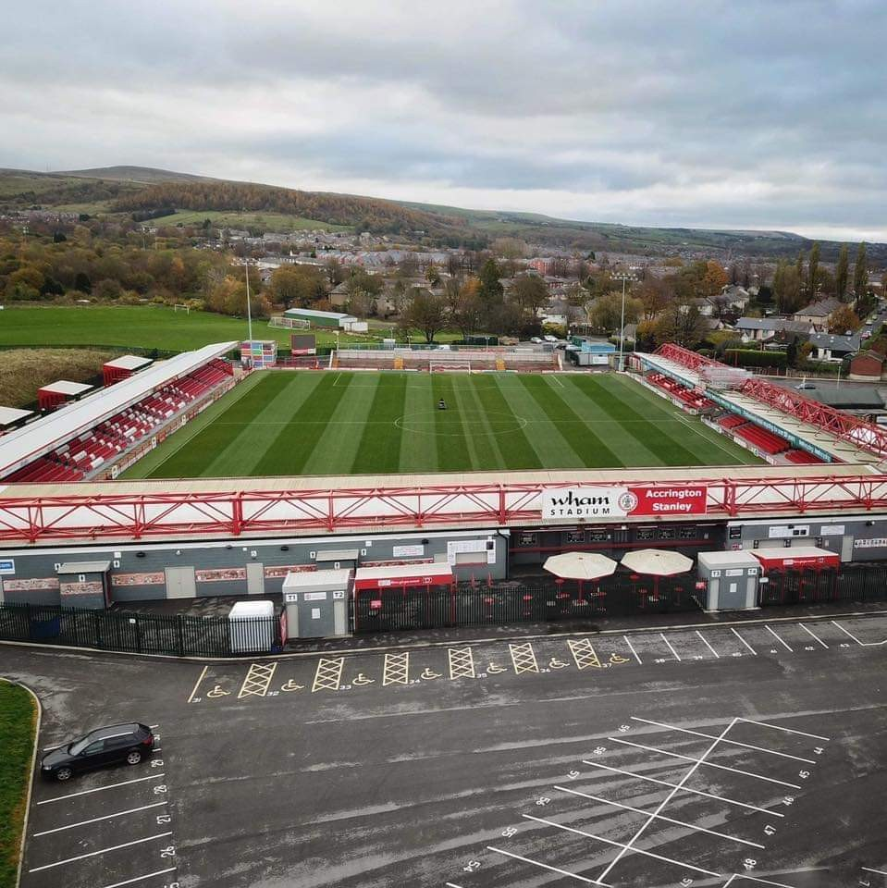
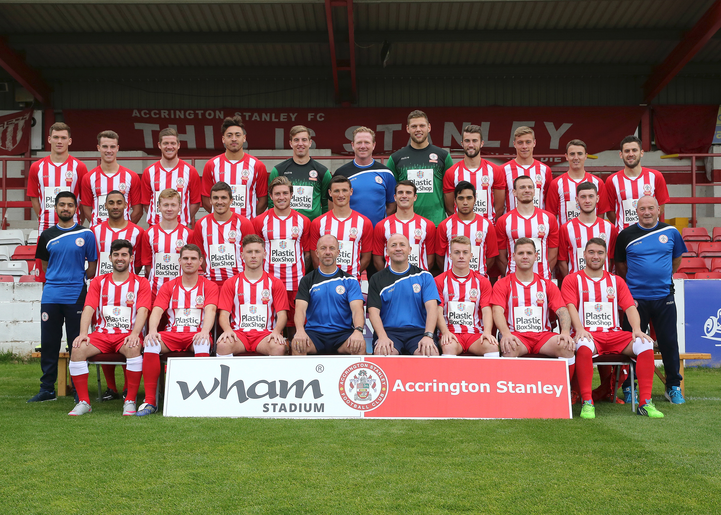

Slide 5
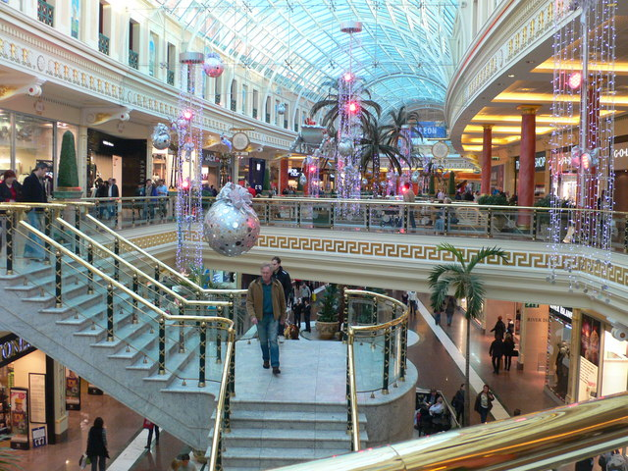
The Trafford Centre
Find the errors (trova gli errori)
Yesterday I go to the Trafford Centre with my friends new from Acrington Academy. We travelled by car down the motorway. It was very busy! When we left, we had some foods. I eated a Big Mac and fries and it was delicious. Then we went for the shopping and I buyd a green t-shirt and a jeans. Later I visited Selfridges, but I didn’t buy anything because it was too much expensive.

Slide 6
The Trafford Centre
Find the errors (trova gli errori)
Yesterday I go to the Trafford Centre with my friends new from Acrington Academy. We travelled by car down the motorway. It was very busy! When we left, we had some foods. I eated a Big Mac and fries and it was delicious. Then we went for the shopping and I buyd a green t-shirt and a * jeans. Later I visited Selfridges, but I didn’t buy anything because it was too much expensive.
Yesterday I went to the Trafford Centre with my new friends from Accrington Academy. We travelled by bus down the motorway. It was very busy! When we arrived, we had some food. I ate a Big Mac and fries and it was delicious. Then we went shopping and I bought a green t-shirt and a pair of jeans. Later I visited Selfridges, but I didn’t buy anything because it was too expensive.

Slide 7
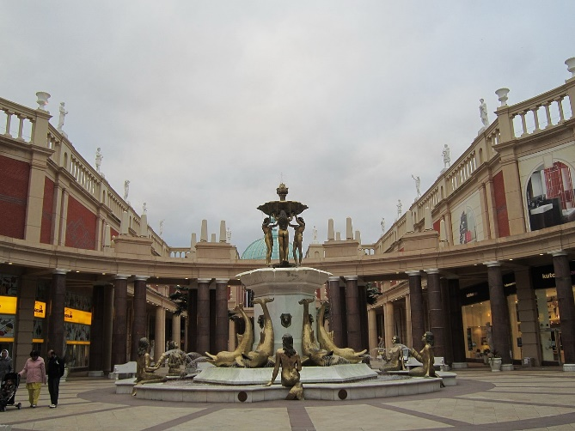
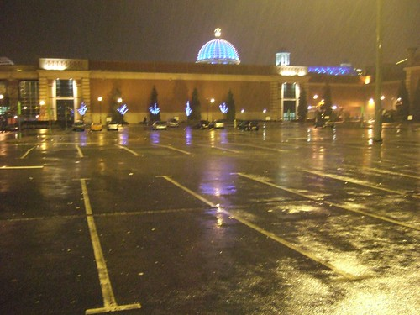
The Trafford Centre
Write about your trip to the Trafford Centre yesterday
Scrivi ieri del tuo viaggio al Trafford Centre
Yesterday I went to the Trafford Centre with my new friends from Accrington Academy. We travelled by bus down the motorway. It was very busy! When we arrived, we had some food. I ate a Big Mac and fries and it was delicious. Then we went shopping and I bought a green t-shirt and a pair of jeans. Later I visited Selfridges, but I didn’t buy anything because it was too expensive.

